Slide 1

Recipe Sharing System Group Name: 30449 NimbusWhiz By ASHA JYOTHI JAKKAN -700746157 SAI SUMANTH LADE- 700745852 VIHARI REDDY MONAJI - 700745437 SAHIL NAIDU PAGADALA - 700748694
Notes:
Intro slide: Hey class, this is sumanth and I'm gonna give the intro of our project. So our project is Recipe sharing platform. It's as simple as the name suggests, people share their recipes in our application. Going into details..

Slide 2
Project Description
This application allows users to share, view, and follow recipes.
Users can upload and share their own recipes. They can also browse and view recipes shared by others.
If users like particular recipes or creators, they can follow them to see new recipes.
The app uses Remix as the web framework. It is hosted on EC2 for the server.
APIs created in API Gateway connect the frontend to AWS Lambda functions. Lambda processes app logic and data.
Lambda also enables logging and notifications via SES. Data is stored in RDS database.
The app provides an interactive community for home cooks to share and discover new recipes.
Notes:
Project Description: Our application lets users to share their recipes, view other users recipes. The recipes can be anything, like either for cooking or some chemical recipe or anything else, And the way it works is, user will upload a pic of their choice, and adds description, instructions, preparation time, ingredients they need and all. We'll give you a picture of the whole scenario it in the demo. And one of the good features of the app is that it has a subscription feature which allows any user to follow their favorite recipe sharer. So, when a user subscribes to their favorite recipes, they a notification through email whenever their favorite one's posts something new just like any other social platform. Moving on to techinicalities, we made this using remix web framework, which is framework of react, used for server-side rendering (SSR). This means that both the backend and the frontend can be made using a single Remix app. Data is rendered on the server and served to the client side with minimum JavaScript. But how did we handle the interactions of the page using AWS cloud?

Slide 3
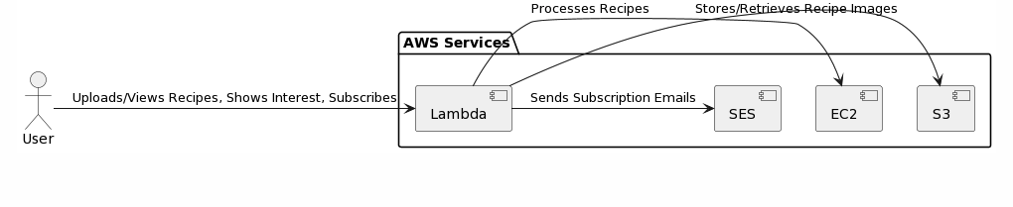
Architecture Diagram
Notes:
Architecture diagram: Here's how, for functionality, the API's created at API gateway connects the front-end to the lambda functions. Then the lambda process the app logic and data. As depicted in this given pic, whenever the user interacts with the application, the lambda gets called and then the lambda process the data and redirects the user to the service they need. Like SES for notification, S3 for images and RDS for getting the user, and recipe information etc.,

Slide 4
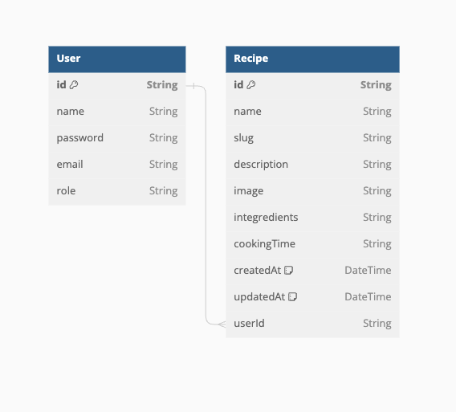
ER Diagram
Notes:
ER diagram: And this the content of the RDS, just two tables connected with userid. user table has all the user info id, name...and the recipe has all the recipe info such as recipe name,description...and also foreign key from user table, which indicates the owner of the recipe. ​​

Slide 5

Services Used
AWS RDS - Amazon Relational Database Service (Amazon RDS) is a collection of managed services that makes it simple to set up, operate, and scale databases in the cloud.
AWS S3 – Amazon S3 is a scalable object storage service that allows you to store and retrieve any amount of data from anywhere on the web.
AWS Lambda - AWS Lambda is a serverless, event-driven compute service that lets you run code for virtually any type of application or backend service without provisioning or managing servers.
AWS ApiGateway - AWS API Gateway is a fully managed service that makes it easy for developers to create, publish, maintain, monitor, and secure APIs at any scale.
AWS SES - Amazon Simple Email Service (SES) is a cost-effective, flexible, and scalable email service that enables sending mail from within any application.
AWS EC2 - Amazon Elastic Compute Cloud (Amazon EC2) is a web service that provides secure, resizable compute capacity in the cloud.

Slide 6
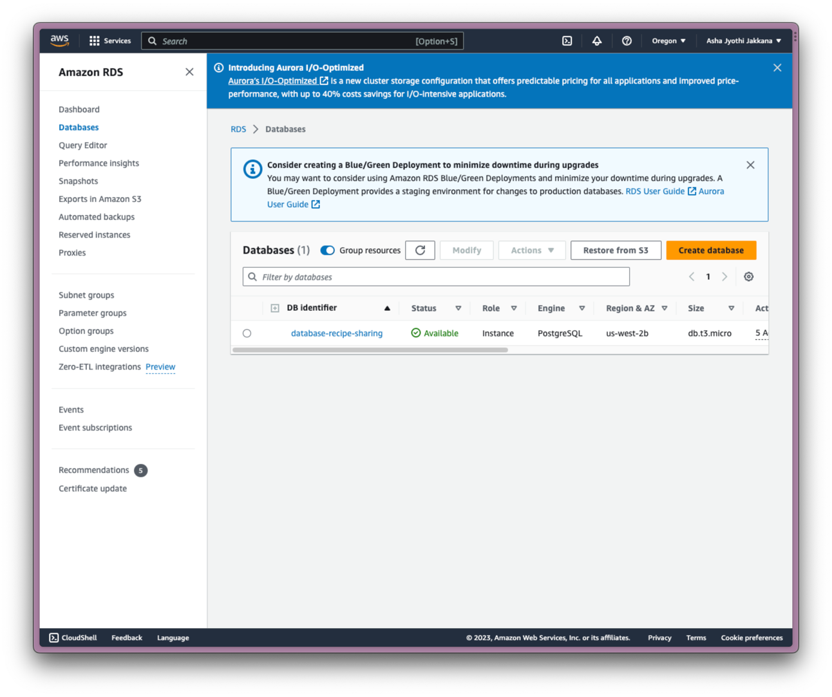
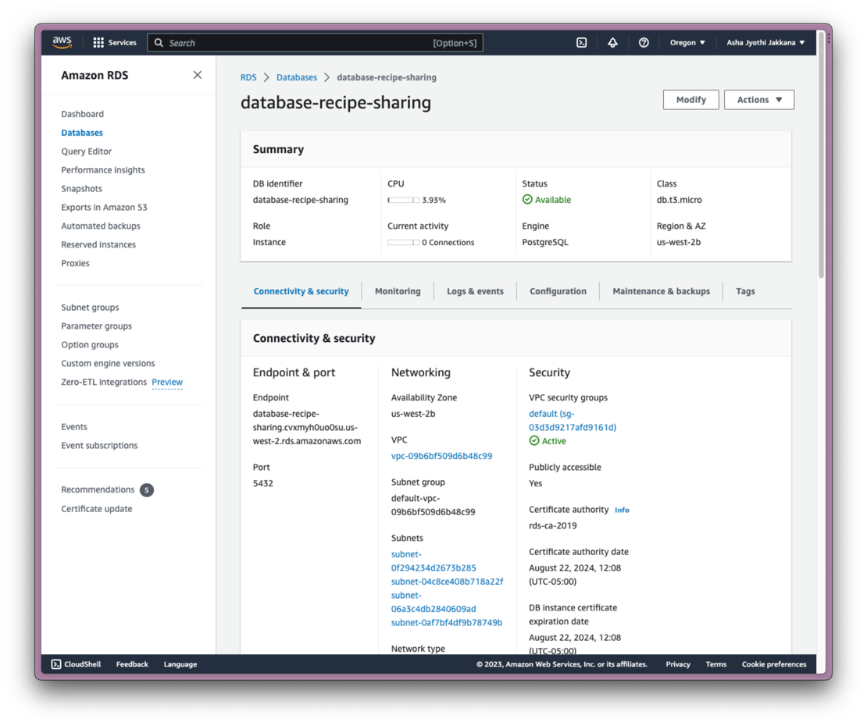
AWS RDS
Offers a user-friendly interface to handle database.
No technical complexities for setting up or one doesn’t need to worry about infrastructure.
Basically, handles the recipe storage.

Slide 7
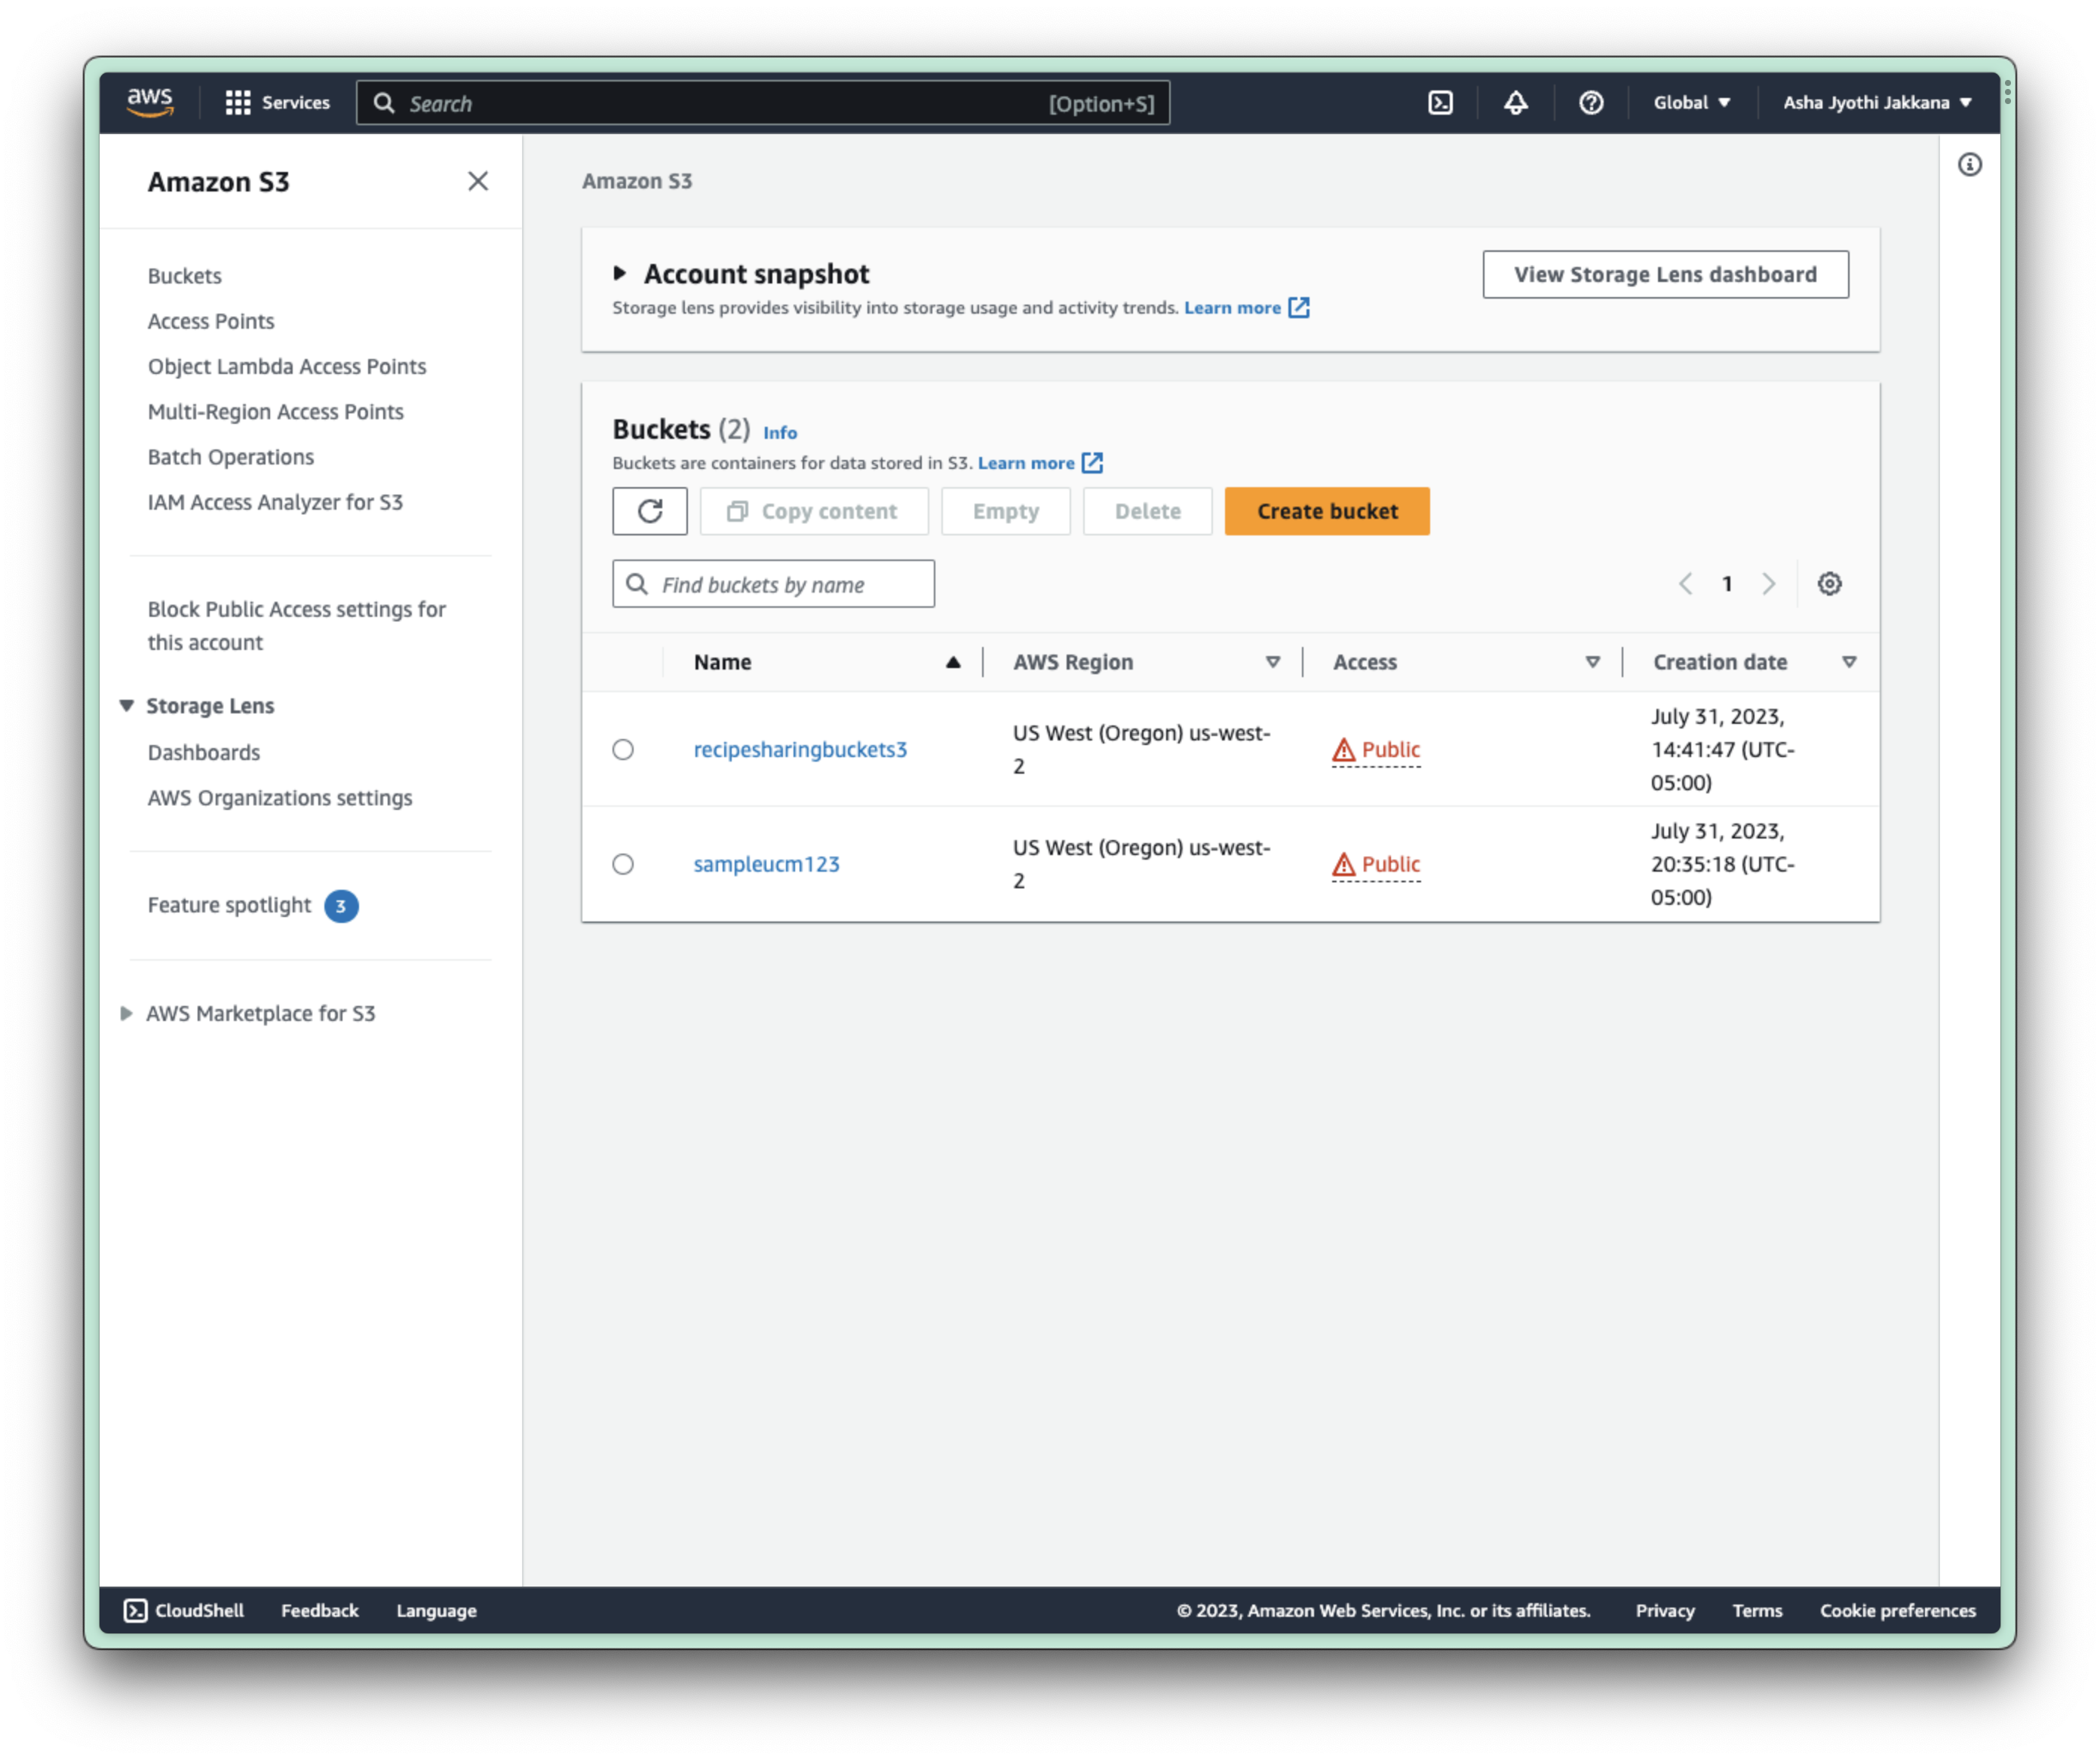
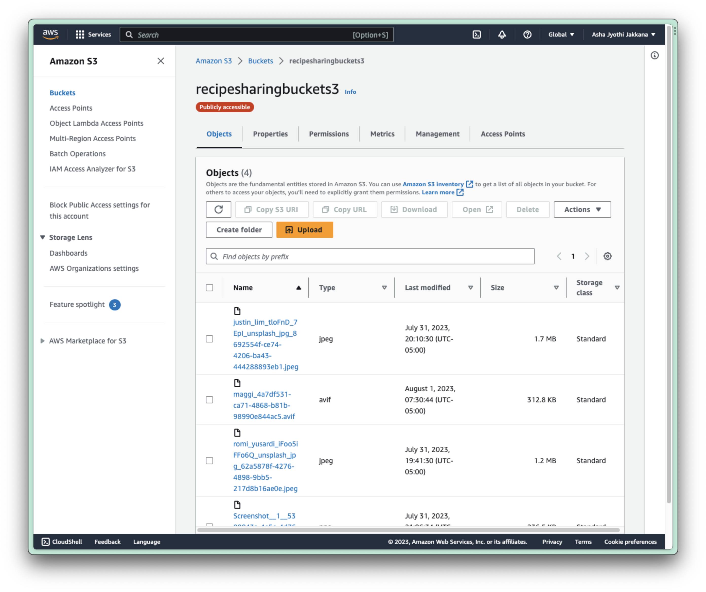
AWS S3
S3 is a scalable object storage service that allows to store and retrieve any amount of data.
Here, we have created the bucket “recipesharingbucket3” and configured it so that it is publicly accessible.
Overall, S3 manages the multimedia content such as images in our case & videos.

Slide 8
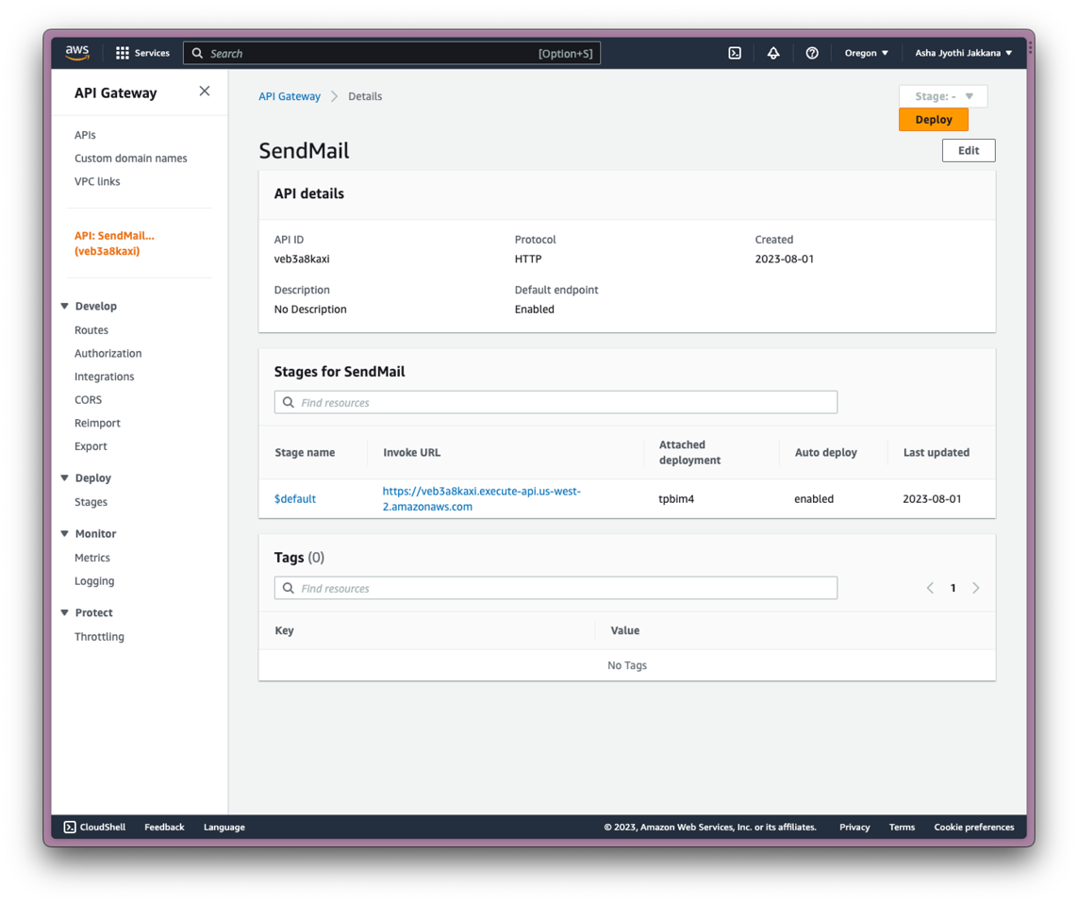
AWS ApiGateway
Triggering Lamda through API Gateway (“SendMail”).
It will create a invoke URL, but useless until Lamda is attached to it.
In this, we can encounter integration details for “SendMail” along with specified config.
API Gateway and Lamda work hand in hand by allowing one to create and publish APIs easily through Gateway & then use Lamda to execute broken code for those APIs.

Slide 9
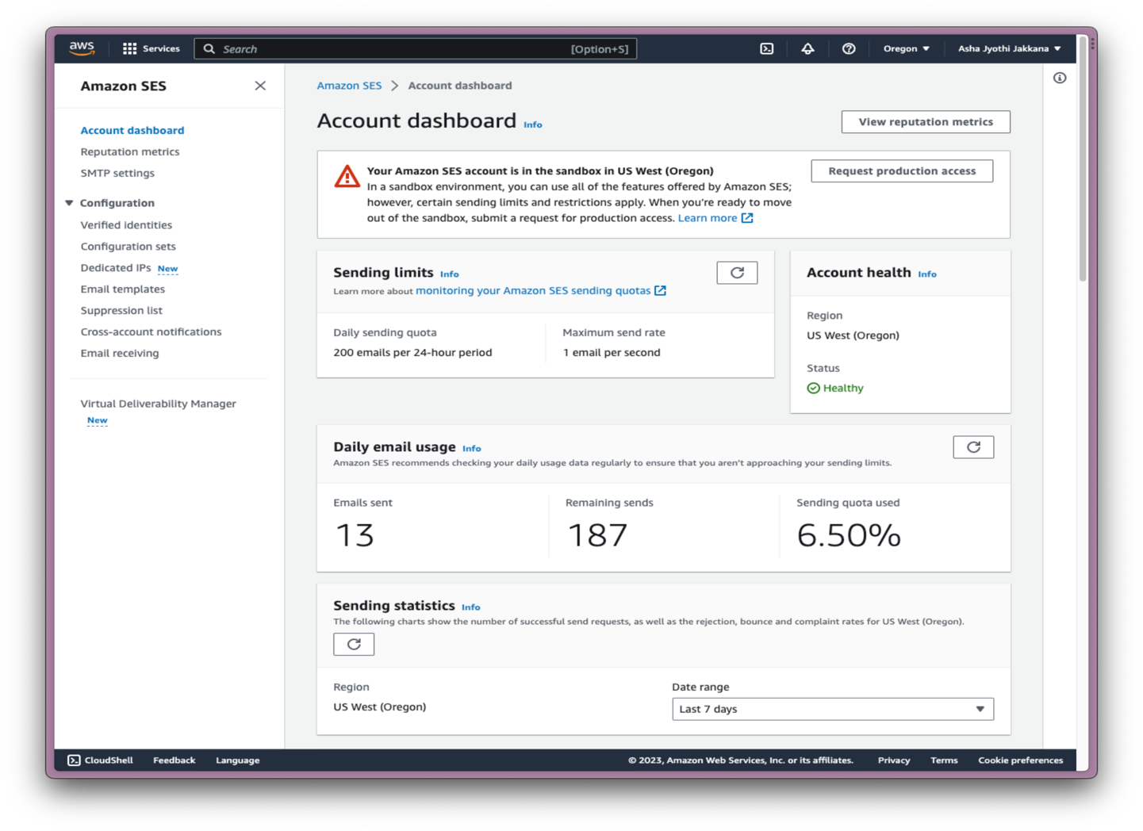
AWS SES
Simple Email Service, enables to send email from within application.
SES in sandbox mode -→ emails can be send b/w the verified emails we’ve created.
Verification emails are send to created emails to avoid sham.

Slide 10
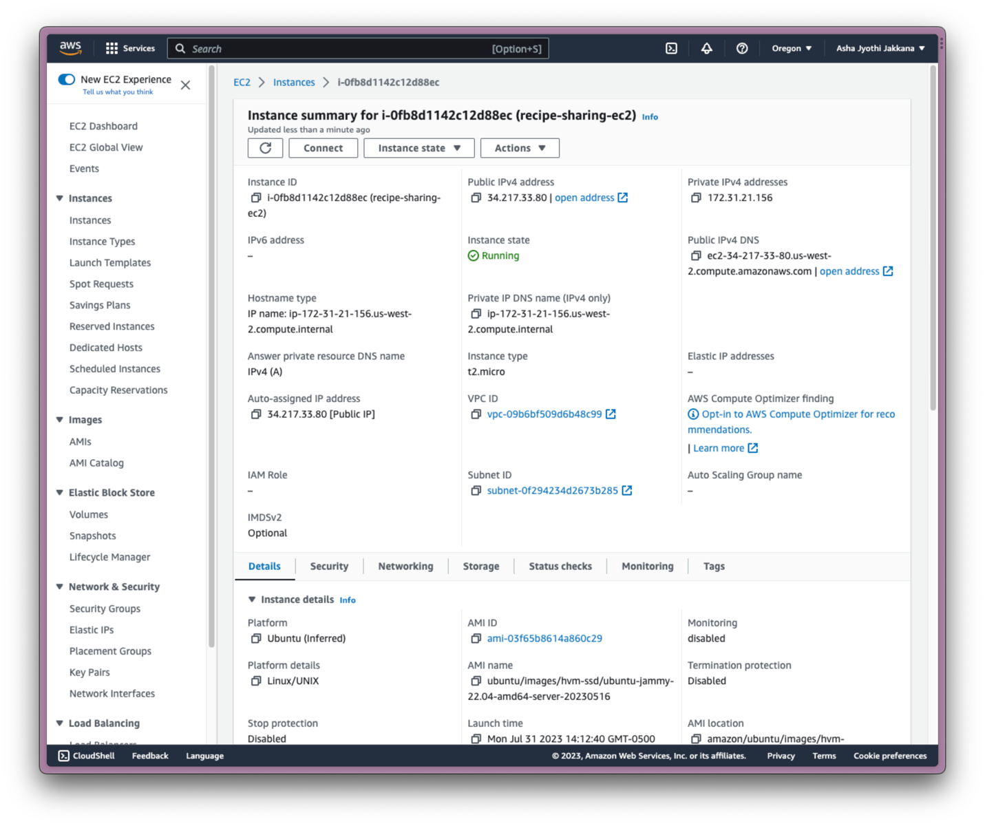
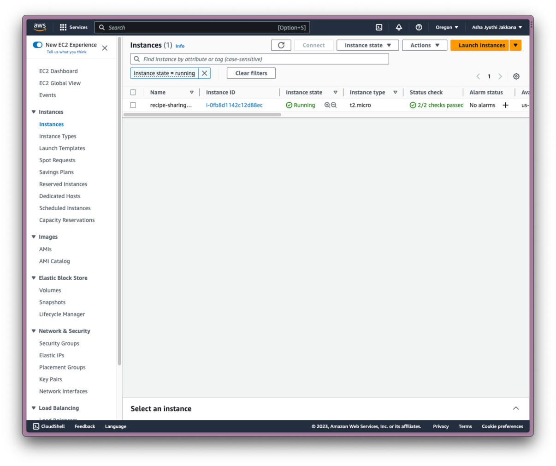
AWS EC2
It is a web service that provides secure, resizable compute in cloud.
In Ec2, we use connect SSH to connect to the platform. Executing few command results in the generation of port number for the server.

Slide 11
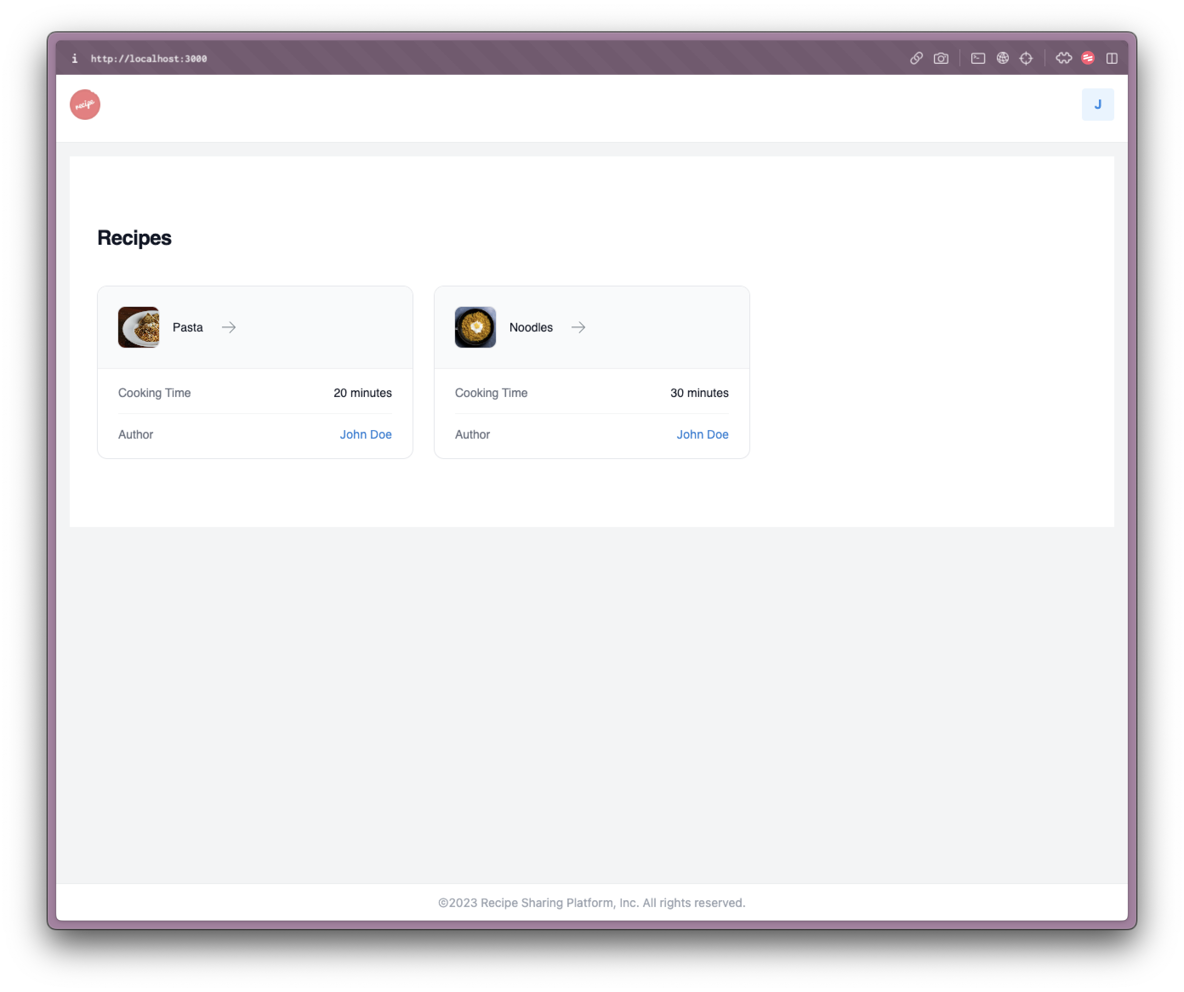
User’s Dashboard

Slide 12
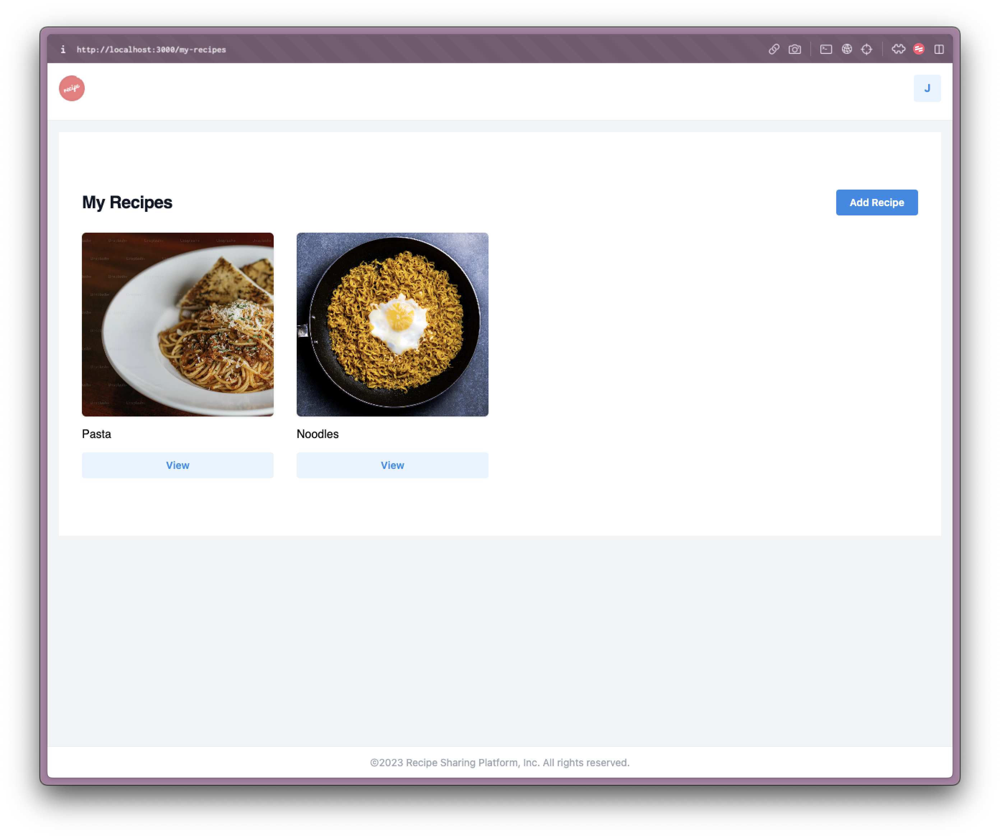
Add their own recipes

Slide 13
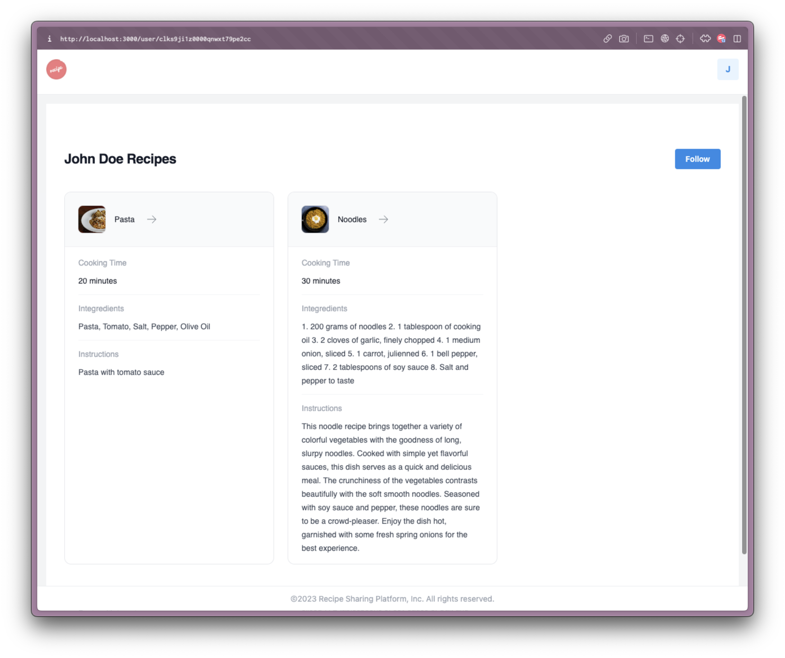
Author’s page

Slide 14
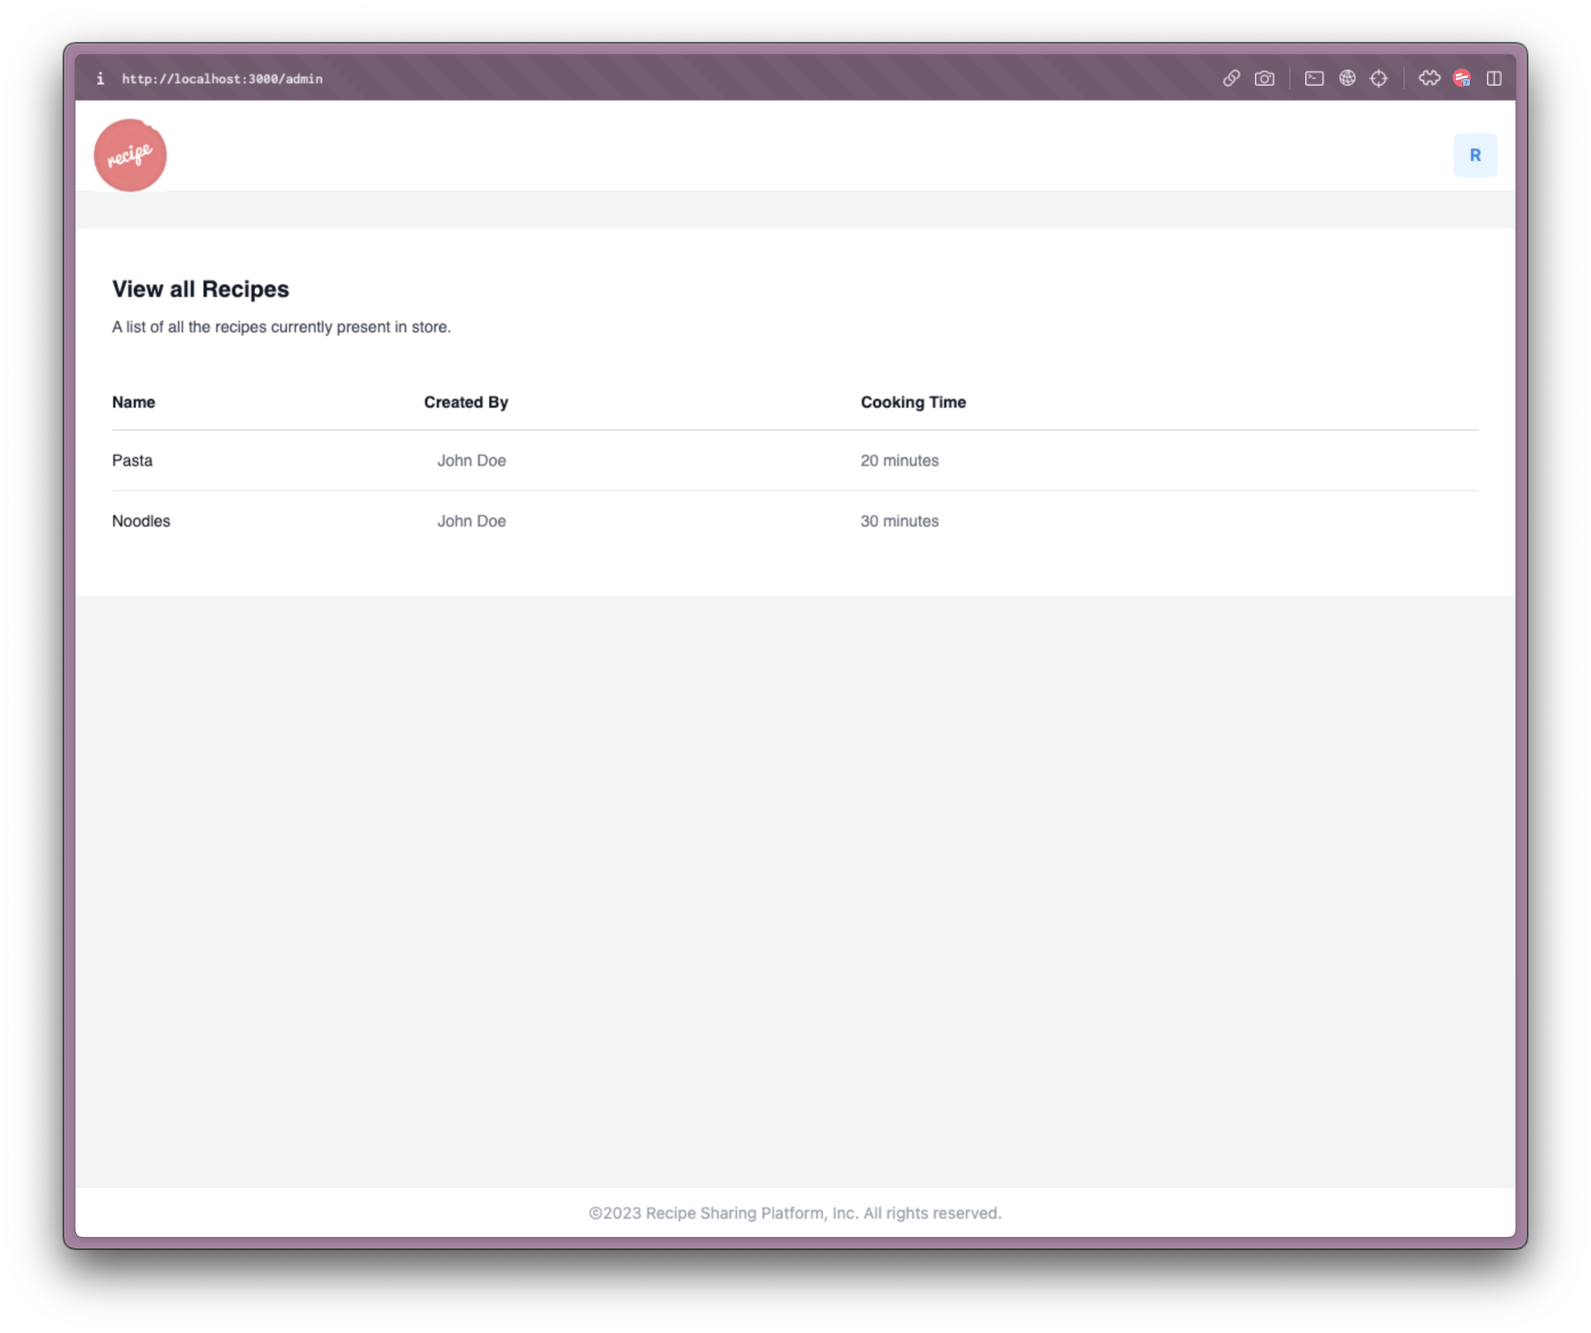
Admin Dashboard

Slide 15
Difficulties faced
Lambda Tests:
Cold-start latency is the time it takes to begin using a function after it has been initialized.
Complexity in monitoring and debugging that necessitates familiarity with CloudWatch.
Constraints on Scalability, Including Concurrent Tuning and Overcoming Throttling Issues.
SES Challenges:
Email Recipients Received Concerns include dealing with undeliverable messages and complaints without damaging your sending reputation.
Setting up authentication techniques like domain key exchange (DKIM) and sender policy framework (SPF) might be complicated.
Setting and controlling transmitting rates, particularly in a test or development setting.

Slide 16
Difficulties faced
EC2 Challenges:
Instance Management: Selecting appropriate instance types, dealing with scaling, and lifecycle handling.
Security Concerns: Configuring security groups, IAM roles, and VPC settings without exposing vulnerabilities.
Cost Optimization: Managing costs related to instance types, storage, and data transfer.
RDS Challenges:
Database Scaling: Implementing read replicas and optimizing performance without downtime.
Backup and Recovery: Configuring automated backups, snapshots, and disaster recovery plans.
Multi-AZ Deployment: Ensuring high availability and failover support, leading to complexities in setup and maintenance.

